Slide 1
Programming with WebGL
Part 1: Background
Matt Evett
Dept. Computer Science
Eastern Michigan Univ.
E. Angel and D. Shreiner: Interactive Computer Graphics 6E © Addison-Wesley 2012

Slide 2
Objectives
Development of the OpenGL API
OpenGL Architecture
  OpenGL as a state machine
  OpenGL as a data flow machine
Functions
  Types
  Formats
Simple program
E. Angel and D. Shreiner: Interactive Computer Graphics 6E © Addison-Wesley 2012

Slide 3
Early History of APIs
IFIPS (1973) formed two committees to come up with a standard graphics API
  Graphical Kernel System (GKS)
    2D but contained good workstation model
  Core
    Both 2D and 3D
  GKS adopted as IS0 and later ANSI standard (1980s)
GKS not easily extended to 3D (GKS-3D)
  Far behind hardware development
E. Angel and D. Shreiner: Interactive Computer Graphics 6E © Addison-Wesley 2012

Slide 4
PHIGS and X
Programmers Hierarchical Graphics System (PHIGS)
  Arose from CAD community
  Database model with retained graphics (structures)
X Window System
  DEC/MIT effort (consortium of 5 universities)
  Client-server architecture with graphics
PEX combined the two
  Not easy to use (all the defects of each)
E. Angel and D. Shreiner: Interactive Computer Graphics 6E © Addison-Wesley 2012

Slide 5
SGI and GL
Silicon Graphics (SGI) revolutionized the graphics workstation by implementing the pipeline in hardware (1982)
To access the system, application programmers used a library called GL
With GL, it was relatively simple to program three dimensional interactive applications
E. Angel and D. Shreiner: Interactive Computer Graphics 6E © Addison-Wesley 2012

Slide 6
OpenGL
The success of GL lead to OpenGL (1992), a platform-independent API that was
  Easy to use
  Close enough to the hardware to get excellent performance
  Focus on rendering
  Omitted windowing and input to avoid window system dependencies
E. Angel and D. Shreiner: Interactive Computer Graphics 6E © Addison-Wesley 2012

Slide 7
OpenGL Evolution
Originally controlled by an Architectural Review Board (ARB)
  Members included SGI, Microsoft, Nvidia, HP, 3DLabs, IBM,…….
  Now Khronos Group
  Was relatively stable (through version 2.5)
    Backward compatible
    Evolution reflected new hardware capabilities
      3D texture mapping and texture objects
      Vertex and fragment programs
  Allows platform specific features through extensions
E. Angel and D. Shreiner: Interactive Computer Graphics 6E © Addison-Wesley 2012

Slide 8
Modern OpenGL
Performance is achieved by using GPU rather than CPU
Control GPU through programs called shaders
Application’s job is to send data to GPU
GPU does all rendering
E. Angel and D. Shreiner: Interactive Computer Graphics 6E © Addison-Wesley 2012

Slide 9
Immediate Mode Graphics
Geometry specified by vertices
  Locations in space( 2 or 3 dimensional)
  Points, lines, circles, polygons, curves, surfaces
Immediate mode
  Each time a vertex is specified in application, its location is sent to the GPU
  Old style uses glVertex
  Creates bottleneck between CPU and GPU
  Removed from OpenGL 3.1 and OpenGL ES 2.0
Angel and Shreiner: Interactive Computer Graphics 7E © Addison-Wesley 2015

Slide 10
Retained Mode Graphics
Put all vertex attribute data in array
Send array to GPU to be rendered immediately
Almost OK but problem is we would have to send array over each time we need another render of it
Better to send array over and store on GPU for multiple renderings
Angel and Shreiner: Interactive Computer Graphics 7E © Addison-Wesley 2015

Slide 11
OpenGL 3.1
Totally shader-based
  No default shaders
  Each application must provide both a vertex and a fragment shader
No immediate mode
Few state variables
Most 2.5 functions deprecated
Backward compatibility not required
  There is a compatibility extension
E. Angel and D. Shreiner: Interactive Computer Graphics 6E © Addison-Wesley 2012

Slide 12
Other Versions
OpenGL ES
  Embedded systems (consoles, phones, etc.)
  Version 1.0 simplified OpenGL 2.1
  Version 2.0 simplified OpenGL 3.1
    Shader based
WebGL
  Javascript implementation of ES 2.0
  Supported on newer browsers
OpenGL 4.1 and 4.2
  Add geometry shaders and tessellator
E. Angel and D. Shreiner: Interactive Computer Graphics 6E © Addison-Wesley 2012

Slide 13
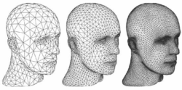
Aside: Tessellation?
Allows simple models to yield complex graphics
E. Angel and D. Shreiner: Interactive Computer Graphics 6E © Addison-Wesley 2012
Notes:
From http://rastergrid.com/blog/2010/09/history-of-hardware-tessellation/

Slide 14
OpenGL and WebGL
First, we’ll take a quick look at OpenGL
Then we’ll look at WebGL in more detail
E. Angel and D. Shreiner: Interactive Computer Graphics 6E © Addison-Wesley 2012

Slide 15
OpenGL Libraries
OpenGL core library
  OpenGL32 on Windows
  GL on most unix/linux systems (libGL.a)
OpenGL Utility Library (GLU)
  Provides functionality in OpenGL core but avoids having to rewrite code
  Will only work with legacy code
Links with window system
  GLX for X window systems
  WGL for Windows
  AGL for Macintosh
E. Angel and D. Shreiner: Interactive Computer Graphics 6E © Addison-Wesley 2012

Slide 16
GLUT
OpenGL Utility Toolkit (GLUT)
  Provides functionality common to all window systems
    Open a window
    Get input from mouse and keyboard
    Menus
    Event-driven
  Code is portable but GLUT lacks the functionality of a good toolkit for a specific platform
    No slide bars
E. Angel and D. Shreiner: Interactive Computer Graphics 6E © Addison-Wesley 2012

Slide 17
freeglut
GLUT was created long ago and has been unchanged
  Amazing that it works with OpenGL 3.1
  Some functionality can’t work since it requires deprecated functions
freeglut updates GLUT
  Added capabilities
  Context checking
E. Angel and D. Shreiner: Interactive Computer Graphics 6E © Addison-Wesley 2012

Slide 18
GLEW
OpenGL Extension Wrangler Library
Makes it easy to access the OpenGL extensions available on a particular system
Avoids having to have specific entry points in Windows code
Application needs only to include glew.h and run a glewInit()
E. Angel and D. Shreiner: Interactive Computer Graphics 6E © Addison-Wesley 2012

Slide 19
What About Direct X?
Windows only
Advantages
  Better control of resources
  Access to high level functionality
Disadvantages
  New versions not backward compatible
  Windows only
Recent advances in shaders are leading to convergence with OpenGL
E. Angel and D. Shreiner: Interactive Computer Graphics 6E © Addison-Wesley 2012

Slide 20
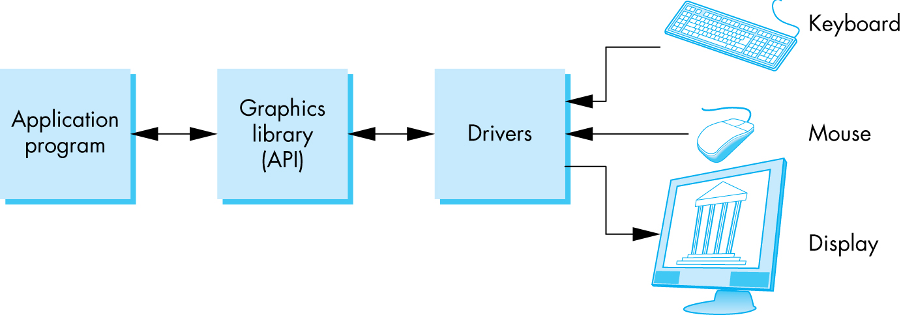
OpenGL Architecture
E. Angel and D. Shreiner: Interactive Computer Graphics 6E © Addison-Wesley 2012

Slide 21
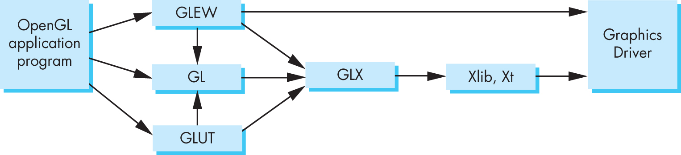
Software Organization
E. Angel and D. Shreiner: Interactive Computer Graphics 6E © Addison-Wesley 2012
Notes:
Here, GLX is the interface library between GL and X Windows

Slide 22
OpenGL Functions
Primitives
  Points
  Line Segments
  Triangles
Attributes
Transformations
  Viewing
  Modeling
Control (GLUT)
Input (GLUT)
Query
E. Angel and D. Shreiner: Interactive Computer Graphics 6E © Addison-Wesley 2012

Slide 23
OpenGL State
OpenGL is a state machine
OpenGL functions are of two types
  Primitive generating
    Can cause output if primitive is visible
    How vertices are processed and appearance of primitive are controlled by the state
  State changing
    Transformation functions
    Attribute functions
    Under 3.1 most state variables are defined by the application and sent to the shaders
E. Angel and D. Shreiner: Interactive Computer Graphics 6E © Addison-Wesley 2012

Slide 24
Lack of Object Orientation
OpenGL is not object oriented so that there are multiple functions for a given logical function
  glUniform3f
  glUniform2i
  glUniform3dv
Underlying storage mode is the same
Easy to create overloaded functions in C++ but issue is efficiency
E. Angel and D. Shreiner: Interactive Computer Graphics 6E © Addison-Wesley 2012

Slide 25
OpenGL function format
function name
dimensions
glUniform3f(x,y,z)
x,y,z are floats
belongs to GL library
glUniform3fv(p)
p is a pointer to an array
E. Angel and D. Shreiner: Interactive Computer Graphics 6E © Addison-Wesley 2012

Slide 26
OpenGL #defines
Most constants are defined in the include files gl.h, glu.h and glut.h
  Note #include <GL/glut.h> should automatically include the others
  Examples
  glEnable(GL_DEPTH_TEST)
  glClear(GL_COLOR_BUFFER_BIT)
include files also define OpenGL data types: GLfloat, GLdouble,….
E. Angel and D. Shreiner: Interactive Computer Graphics 6E © Addison-Wesley 2012

Slide 27
OpenGL and GLSL
Shader based OpenGL is based less on a state machine model than a data flow model
Most state variables, attributes and related pre 3.1 OpenGL functions have been deprecated
Action happens in shaders
Application’s job is to get data to GPU
E. Angel and D. Shreiner: Interactive Computer Graphics 6E © Addison-Wesley 2012

Slide 28
GLSL
OpenGL Shading Language
C-like with
  Matrix and vector types (2, 3, 4 dimensional)
  Overloaded operators
  C++ like constructors
Similar to Nvidia’s Cg and Microsoft HLSL
Code sent to shaders as source code
New OpenGL functions to compile, link and get information to shaders
E. Angel and D. Shreiner: Interactive Computer Graphics 6E © Addison-Wesley 2012

Slide 29
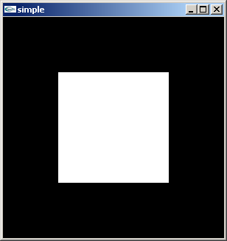
A Simple Program (?)
Generate a square on a solid background
E. Angel and D. Shreiner: Interactive Computer Graphics 6E © Addison-Wesley 2012

Slide 30
It used to be easy
#include <GL/glut.h>
void mydisplay(){
glClear(GL_COLOR_BUFFER_BIT);
glBegin(GL_QUAD;
glVertex2f(-0.5, -0.5);
glVertex2f(-0,5, 0,5);
glVertex2f(0.5, 0.5);
glVertex2f(0.5, -0.5);
glEnd()
}
int main(int argc, char** argv){
glutCreateWindow("simple");
glutDisplayFunc(mydisplay);
glutMainLoop();
}
E. Angel and D. Shreiner: Interactive Computer Graphics 6E © Addison-Wesley 2012

Slide 31
What happened
Most OpenGL functions deprecated
  immediate vs retained mode
  make use of GPU
Makes heavy use of state variable default values that no longer exist
  Viewing
  Colors
  Window parameters
However, processing loop is the same
E. Angel and D. Shreiner: Interactive Computer Graphics 6E © Addison-Wesley 2012

Slide 32
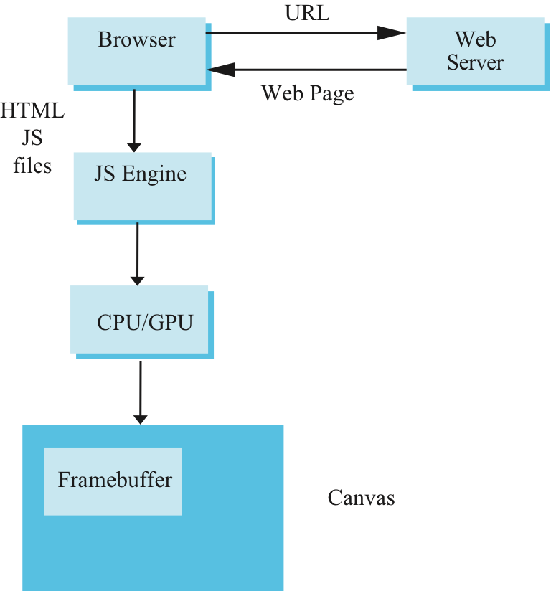
Execution in Browser
Angel and Shreiner: Interactive Computer Graphics 7E © Addison-Wesley 2015

Slide 33
simple.c
#include <GL/glut.h>
void mydisplay(){
glClear(GL_COLOR_BUFFER_BIT);
// need to fill in this part
// and add shaders
}
int main(int argc, char** argv){
glutCreateWindow("simple");
glutDisplayFunc(mydisplay);
glutMainLoop();
}
E. Angel and D. Shreiner: Interactive Computer Graphics 6E © Addison-Wesley 2012

Slide 34
Event Loop
Each programs specifies a render function that is an event listener or callback function
  Every program should have a render callback
  For a static application we need only execute the render function once
  In a dynamic application, the render function can call itself recursively but each redrawing of the display must be triggered by an event
Angel and Shreiner: Interactive Computer Graphics 7E © Addison-Wesley 2015

Slide 35
Event Loop
Note that the program specifies a display callback function named mydisplay
  Every glut program must have a display callback
  The display callback is executed whenever OpenGL decides the display must be refreshed, for example when the window is opened
  The main function ends with the program entering an event loop
E. Angel and D. Shreiner: Interactive Computer Graphics 6E © Addison-Wesley 2012

Slide 36
Notes on compilation
See website and ftp for examples
Unix/linux
  Include files usually in …/include/GL
  Compile with –lglut –lgl loader flags
  May have to add –L flag for X libraries
  Mesa implementation included with most linux distributions
  Check web for latest versions of Mesa and glut
E. Angel and D. Shreiner: Interactive Computer Graphics 6E © Addison-Wesley 2012

Slide 37
Compilation on Windows
Visual C++
  Get glut.h, glut32.lib and glut32.dll from web
  Install in same places as corresponding OpenGL files
  Create an empty application
  Add glut32.lib to project settings (under link tab)
  Same for freeglut and GLEW
Cygwin (linux under Windows)
  Can use gcc and similar makefile to linux
  Use –lopengl32–lglut32 flags
E. Angel and D. Shreiner: Interactive Computer Graphics 6E © Addison-Wesley 2012

Slide 38
Lack of Object Orientation
All versions of OpenGL are not object oriented so that there are multiple functions for a given logical function
Example: sending values to shaders
  gl.uniform3f
  gl.uniform2i
  gl.uniform3dv
Underlying storage mode is the same
Angel and Shreiner: Interactive Computer Graphics 7E © Addison-Wesley 2015

Slide 39
WebGL function format
function name
dimension
gl.uniform3f(x,y,z)
x,y,z are variables
belongs to WebGL canvas
gl.uniform3fv(p)
p is an array
Angel and Shreiner: Interactive Computer Graphics 7E © Addison-Wesley 2015

Slide 40
WebGL constants
Most constants are defined in the canvas object
  In desktop OpenGL, they were in #include files such as gl.h
Examples
  desktop OpenGL
    glEnable(GL_DEPTH_TEST);
  WebGL
    gl.enable(gl.DEPTH_TEST)
  gl.clear(gl.COLOR_BUFFER_BIT)
Angel and Shreiner: Interactive Computer Graphics 7E © Addison-Wesley 2015

Slide 41
WebGL and GLSL
WebGL requires shaders and is based less on a state machine model than a data flow model
Most state variables, attributes and related pre 3.1 OpenGL functions have been deprecated
Action happens in shaders
Job of application is to get data to GPU
Angel and Shreiner: Interactive Computer Graphics 7E © Addison-Wesley 2015

Slide 42
GLSL
OpenGL Shading Language
C-like with
  Matrix and vector types (2, 3, 4 dimensional)
  Overloaded operators
  C++ like constructors
Similar to Nvidia’s Cg and Microsoft HLSL
Code sent to shaders as source code
WebGL functions compile, link and get information to shaders
Angel and Shreiner: Interactive Computer Graphics 7E © Addison-Wesley 2015

Slide 43
Make a Simple Program
Build a complete first program
  Introduce shaders
  Introduce a standard program structure
Simple viewing
  Two-dimensional viewing as a special case of three-dimensional viewing
Initialization steps and program structure
Angel and Shreiner: Interactive Computer Graphics 7E © Addison-Wesley 2015

Slide 44
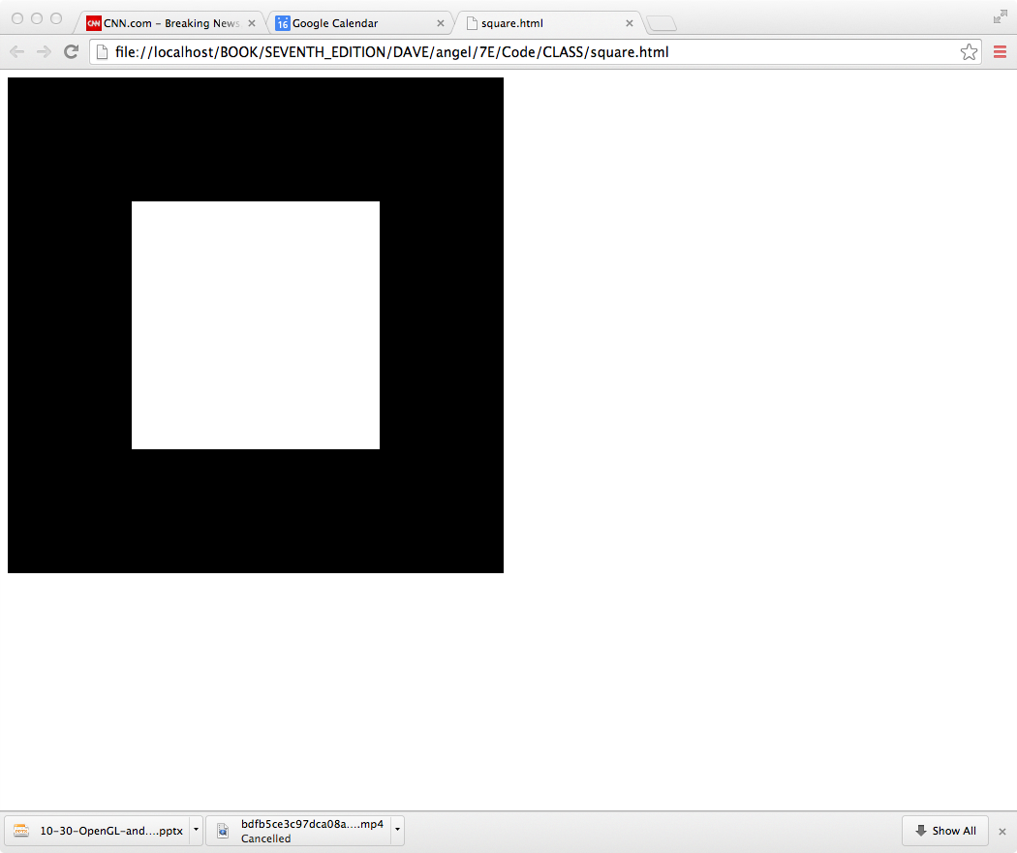
Square Program
Angel and Shreiner: Interactive Computer Graphics 7E © Addison-Wesley 2015
Notes:
I’ve placed this in the Chapter 2

Slide 45
WebGL
Five steps
  Describe page (HTML file)
    request WebGL Canvas
    read in necessary files
  Define shaders (HTML file)
    could be done with a separate file (browser dependent)
  Compute or specify data (JS file)
  Send data to GPU (JS file)
  Render data (JS file)
Angel and Shreiner: Interactive Computer Graphics 7E © Addison-Wesley 2015

Slide 46
square.html
<!DOCTYPE html>
<html>
<head>
<script id="vertex-shader" type="x-shader/x-vertex">
attribute vec4 vPosition;
void main()
{
gl_Position = vPosition;
}
</script>
<script id="fragment-shader" type="x-shader/x-fragment">
precision mediump float;
void main()
{
gl_FragColor = vec4( 1.0, 1.0, 1.0, 1.0 );
}
</script>
Angel and Shreiner: Interactive Computer Graphics 7E © Addison-Wesley 2015

Slide 47
Shaders
We assign names to the shaders that we can use in the JS file
These are trivial pass-through (do nothing) shaders that set the two required built-in variables
  gl_Position
  gl_FragColor
Note both shaders are full programs
Note vector type vec2
Must set precision in fragment shader
Angel and Shreiner: Interactive Computer Graphics 7E © Addison-Wesley 2015

Slide 48
square.html (cont)
<script type="text/javascript" src="../Common/webgl-utils.js"></script>
<script type="text/javascript" src="../Common/initShaders.js"></script>
<script type="text/javascript" src="../Common/MV.js"></script>
<script type="text/javascript" src="square.js"></script>
</head>
<body>
<canvas id="gl-canvas" width="512" height="512">
Oops ... your browser doesn't support the HTML5 canvas element
</canvas>
</body>
</html>
Angel and Shreiner: Interactive Computer Graphics 7E © Addison-Wesley 2015

Slide 49
Files
../Common/webgl-utils.js: Standard utilities for setting up WebGL context in Common directory on website
../Common/initShaders.js: contains JS and WebGL code for reading, compiling and linking the shaders
../Common/MV.js: our matrix-vector package
square.js: the application file
Angel and Shreiner: Interactive Computer Graphics 7E © Addison-Wesley 2015

Slide 50
square.js
var gl;
var points;
window.onload = function init(){
  var canvas = document.getElementById( "gl-canvas" );
gl = WebGLUtils.setupWebGL( canvas );
if ( !gl ) { alert( "WebGL isn't available" );
}
// Four Vertices
var vertices = [
vec2( -0.5, -0.5 ),
vec2( -0.5, 0.5 ),
vec2( 0.5, 0.5 ),
vec2( 0.5, -0.5)
];
Angel and Shreiner: Interactive Computer Graphics 7E © Addison-Wesley 2015

Slide 51
Notes
onload: determines where to start execution when all code is loaded
canvas gets WebGL context from HTML file
vertices use vec2 type in MV.js
JS array is not the same as a C or Java array
  object with methods
  vertices.length // 4
Values in clip coordinates
Angel and Shreiner: Interactive Computer Graphics 7E © Addison-Wesley 2015

Slide 52
square.js (cont)
// Configure WebGL
gl.viewport( 0, 0, canvas.width, canvas.height );
gl.clearColor( 0.0, 0.0, 0.0, 1.0 );
// Load shaders and initialize attribute buffers
var program = initShaders( gl, "vertex-shader", "fragment-shader" );
gl.useProgram( program );
// Load the data into the GPU
var bufferId = gl.createBuffer();
gl.bindBuffer( gl.ARRAY_BUFFER, bufferId );
gl.bufferData( gl.ARRAY_BUFFER, flatten(vertices), gl.STATIC_DRAW );
// Associate out shader variables with our data buffer
var vPosition = gl.getAttribLocation( program, "vPosition" );
gl.vertexAttribPointer( vPosition, 2, gl.FLOAT, false, 0, 0 );
gl.enableVertexAttribArray( vPosition );
Angel and Shreiner: Interactive Computer Graphics 7E © Addison-Wesley 2015

Slide 53
Notes
initShaders used to load, compile and link shaders to form a program object
Load data onto GPU by creating a vertex buffer object on the GPU
  Note use of flatten() to convert JS array to an array of float32’s
Finally we must connect variable in program with variable in shader
  need name, type, location in buffer
Angel and Shreiner: Interactive Computer Graphics 7E © Addison-Wesley 2015

Slide 54
square.js (cont)
render();
};
function render() {
gl.clear( gl.COLOR_BUFFER_BIT );
gl.drawArrays( gl.TRIANGLE_FAN, 0, 4 );
}
1
2
3
0
Angel and Shreiner: Interactive Computer Graphics 7E © Addison-Wesley 2015

Slide 55
Triangles, Fans or Strips
gl.drawArrays( gl.TRIANGLES, 0, 6 ); // 0, 1, 2, 0, 2, 3
gl.drawArrays( gl.TRIANGLE_FAN, 0, 4 ); // 0, 1 , 2, 3
1
2
1
2
0
3
0
3
gl.drawArrays( gl.TRIANGLE_STRIP, 0, 4 ); // 0, 1, 3, 2
Angel and Shreiner: Interactive Computer Graphics 7E © Addison-Wesley 2015

